Slide 1
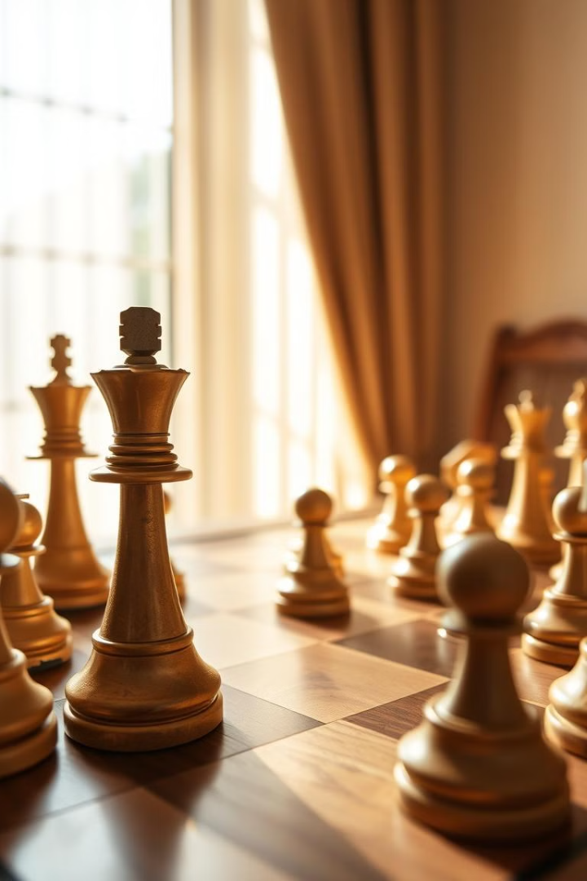
Chess Game Development:
A Genetic Algorithm Approach
This presentation will dive into the creation of a chess game powered by a genetic algorithm, highlighting its innovative approach to AI-driven gameplay and user interface design.

Slide 2
Introduction
The Game of Chess
AI Advancement
A strategic game played on an 8x8 board, each side starts with 16 pieces, demanding intellect and skill.
Artificial intelligence and algorithms have significantly advanced the game of chess, providing innovative analysis and gameplay.

Slide 3
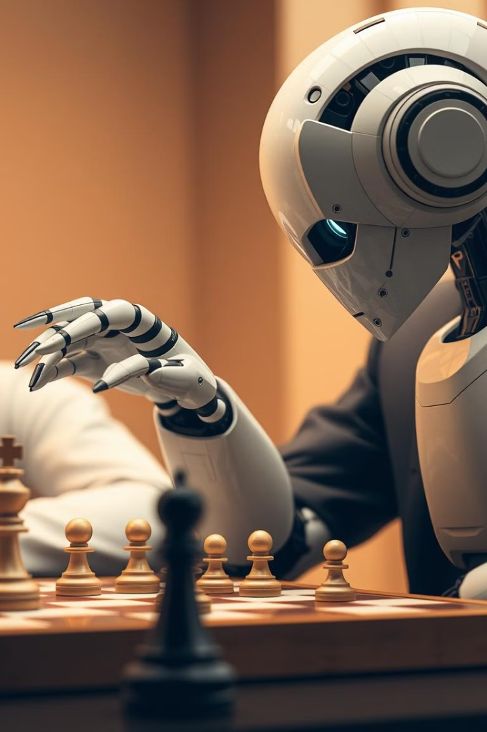
Problem Description
1
Complexity
2
Beginner Challenges
Chess is incredibly complex with countless possible moves and outcomes.
Many beginners struggle to grasp game dynamics and make informed decisions.

Slide 4
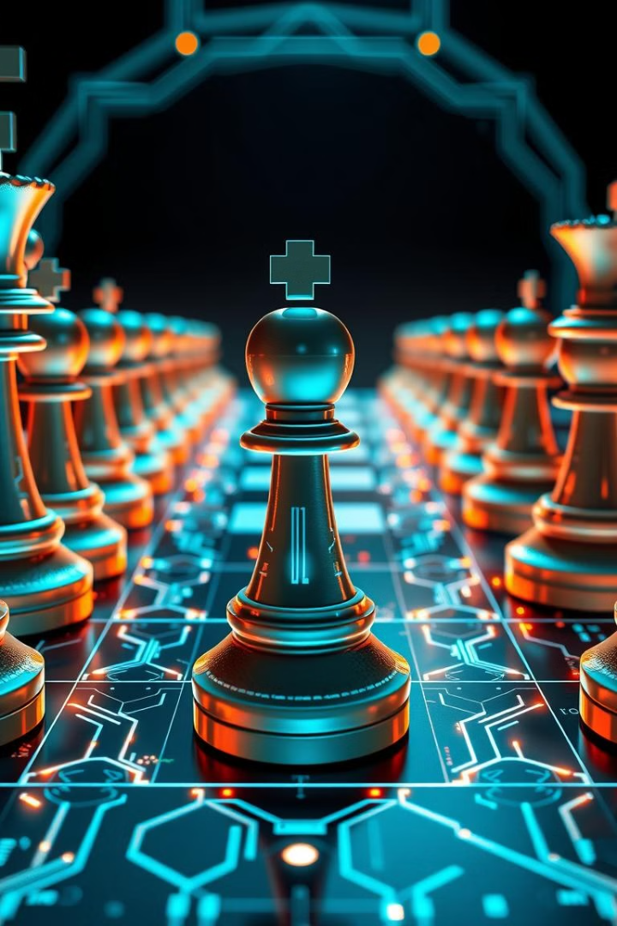
Program Functionality and Inputs/Outputs
GUI
AI Opponent
Intuitive GUI for user interaction with the chessboard and pieces.
Genetic algorithm opponent to evaluate and select optimal moves.
Inputs
Outputs
Player moves and AI parameters.
Visual updates, game event notifications, and AI move display.

Slide 5
Team Roles
Genetic Algorithm
GUI Development
Testing & Integration
Judy, Mesk, and Omar developed the core AI logic for the chess game's opponent.
Basmala, Asmaa, and Adham designed and built the interactive user interface, creating an intuitive experience for players.
Mesk meticulously tested the game's functionality, ensured reliability, and integrated all components seamlessly.

Slide 6
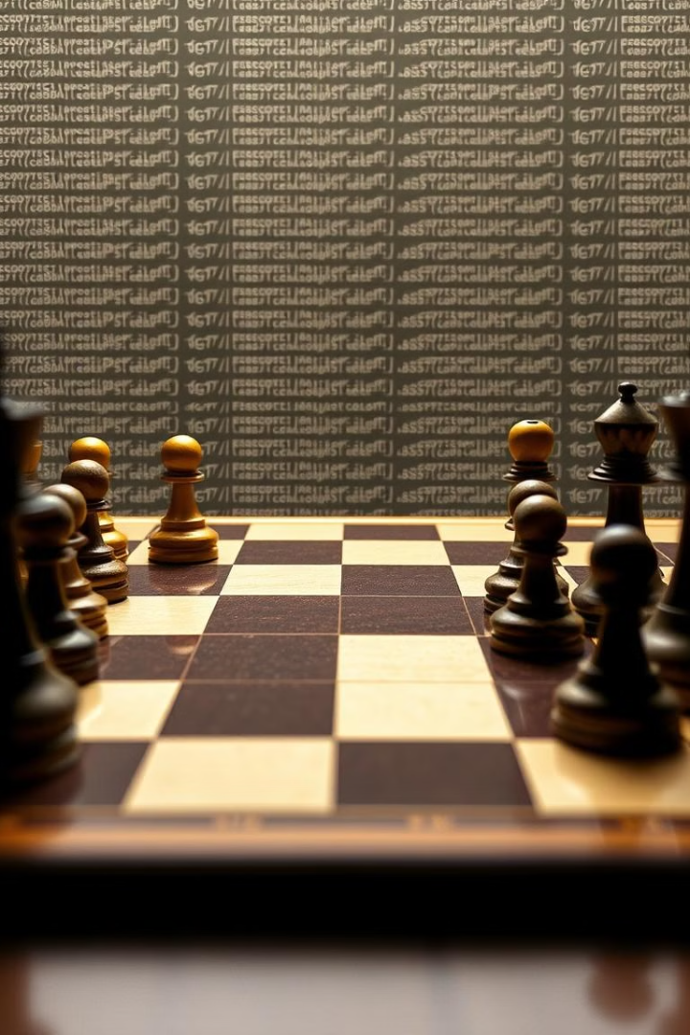
Program Implementation
1
Libraries
Customtkinter, python-chess, Pillow, and random.
2
Genetic Algorithm
Evaluates move fitness, calculates scores, and applies genetic algorithm.
3
GUI Class
Initializes the main window, displays menus, and manages board interactions.

Slide 7
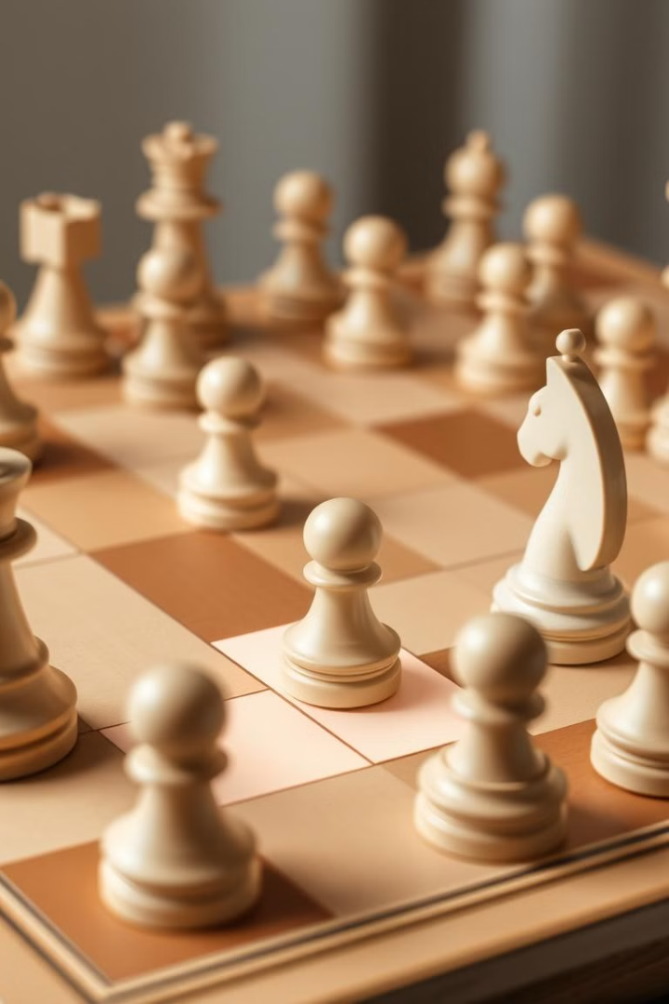



Key Features
Modern GUI
Customtkinter provides an intuitive and user-friendly experience.
Python-Chess Integration
Manages game state, legal moves, and checkmate/stalemate conditions.
Dynamic Display
Facilitates interactive gameplay through mouse events.

Slide 8

Conclusion
This chess game implementation offers a solid foundation for learning and expanding chess AI systems. It incorporates a user-friendly GUI and a genetic algorithm capable of learning and adapting to various board positions, paving the way for more sophisticated AI engines.

Slide 9
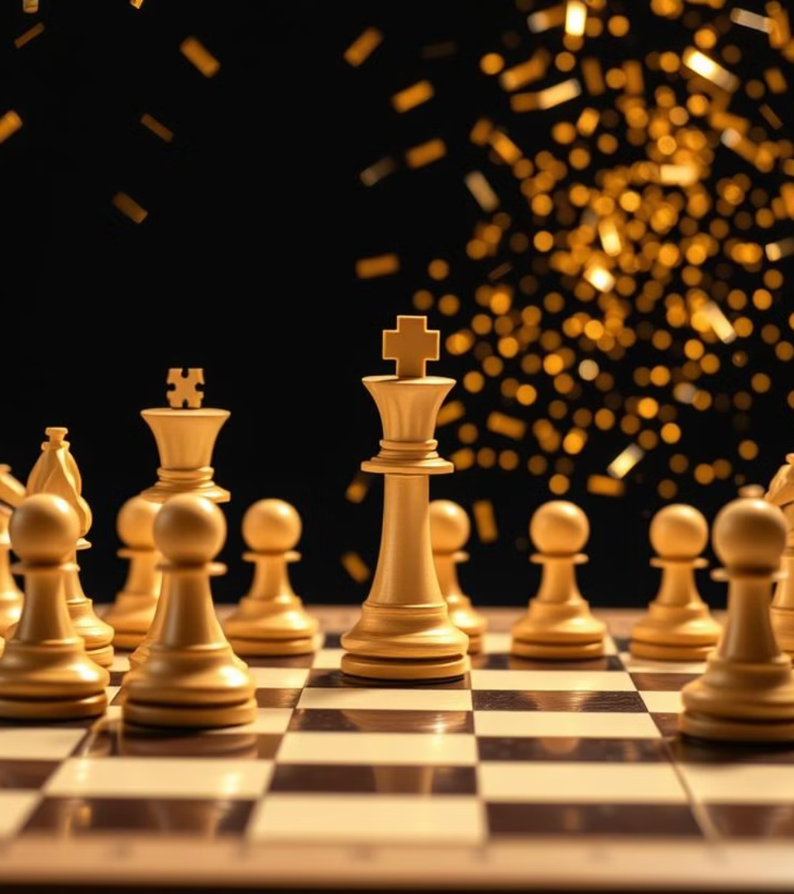
Thank You !

